Slide 1
Brain Tumour Segmentation
Name : Arvind Agarwal
Roll no. : 21BD1A660B
Class : CSM-A

Slide 2
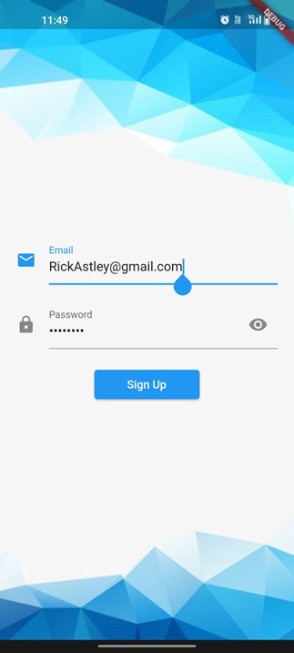
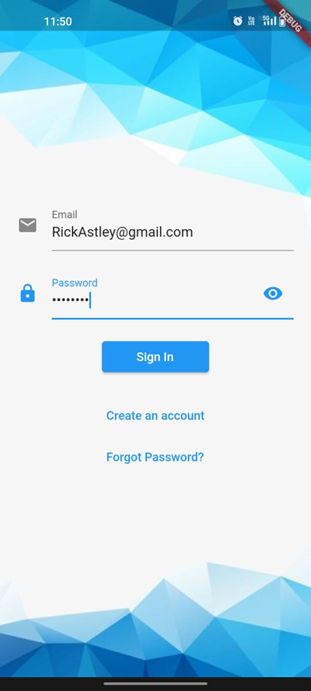
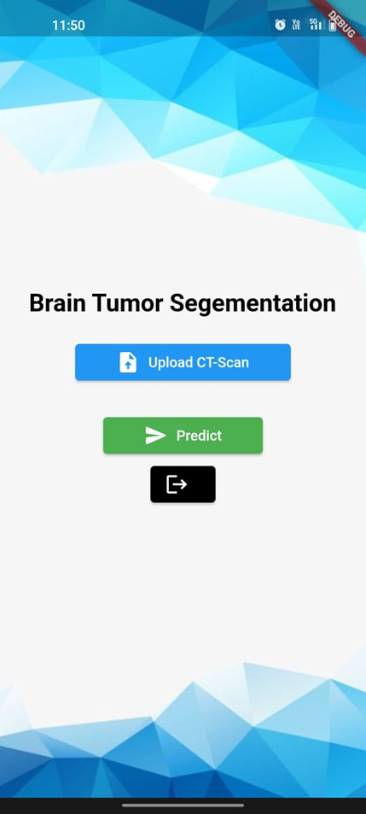
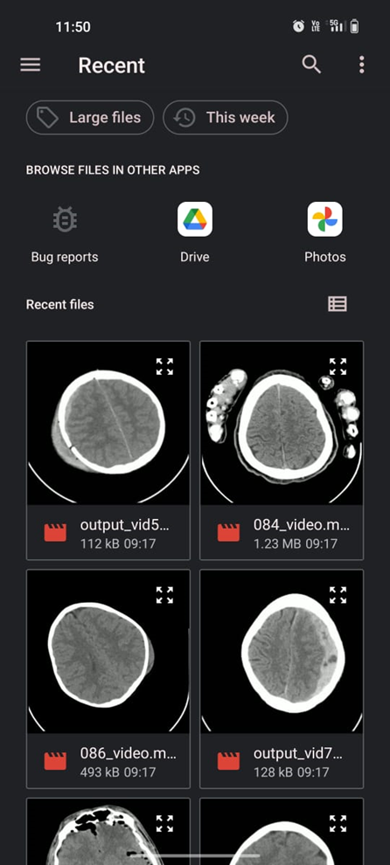
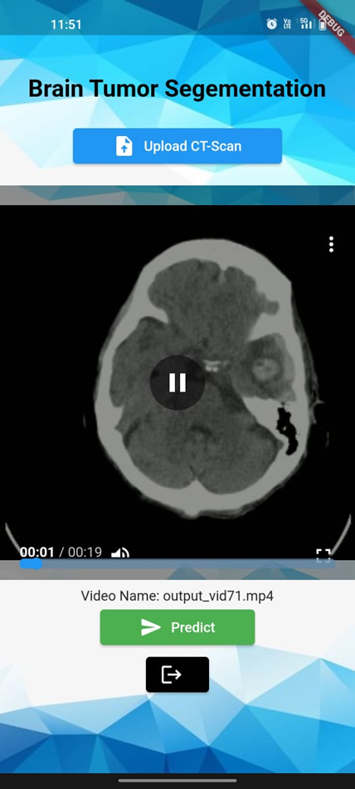
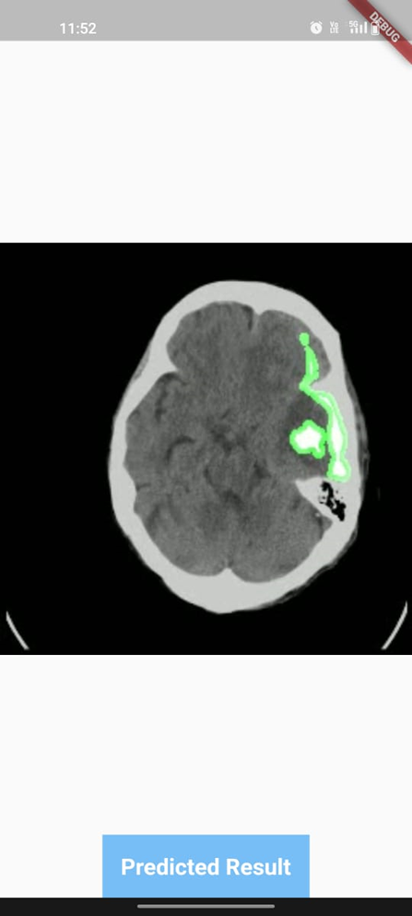
Brain Tumour Segmentation
Flutter App:

Slide 3
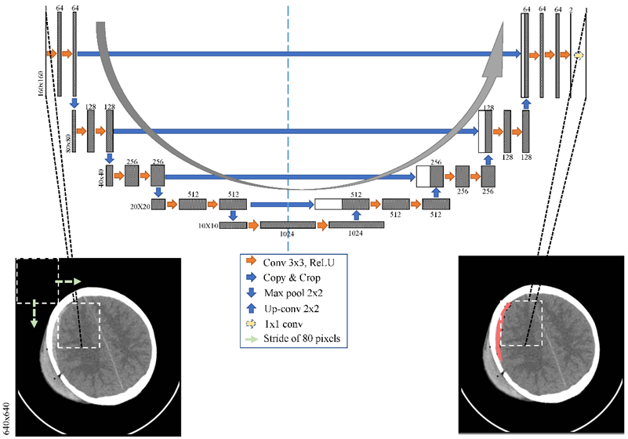
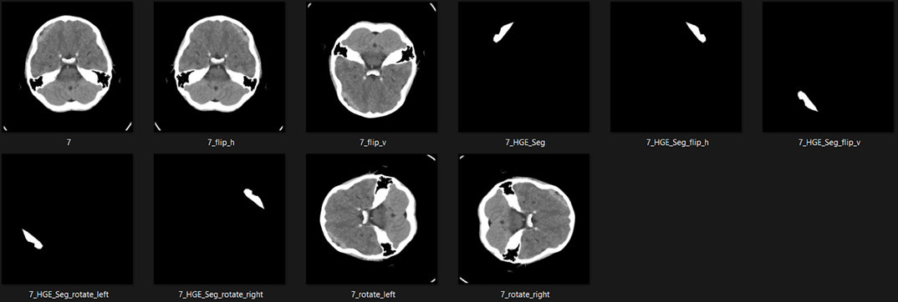
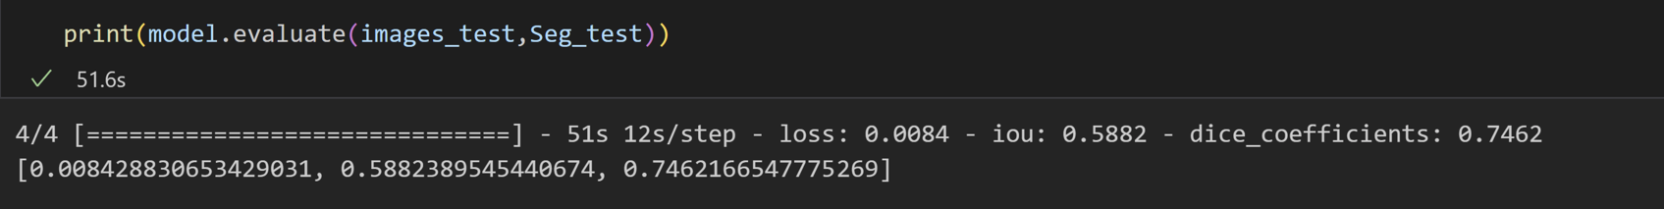
Brain Tumour Segmentation
Dataset: Dataset_Source
Model Description:
UNET is a convolutional neural network architecture specifically designed for semantic segmentation tasks.
Augmented Data
Testing Accuracy :
Sources:
Understanding Segmentation
analytics_vidhya
Training Accuracy :

Slide 4
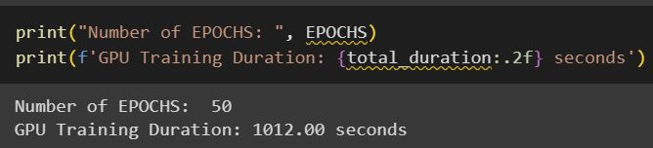
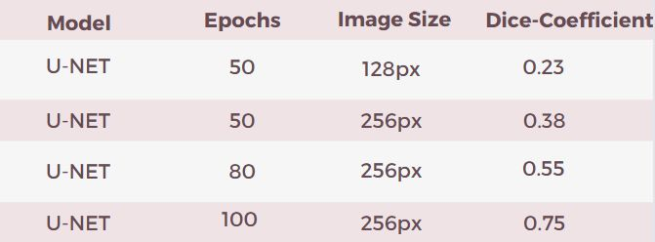
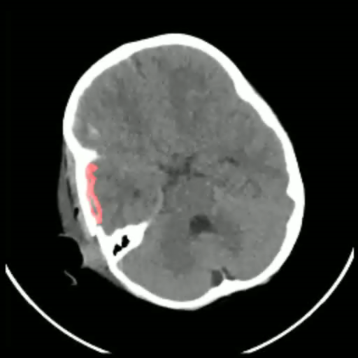
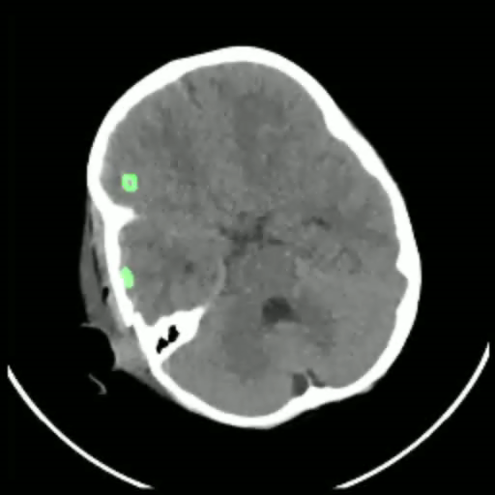
Brain Tumour Segmentation
Model Comparison:
GPU training (Horovod):
Model Accuracy:
CPU training:
CPU Training Duration : 15 hours
Ground Truth
Predicted Result

Slide 5


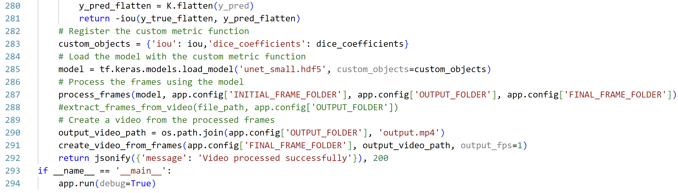
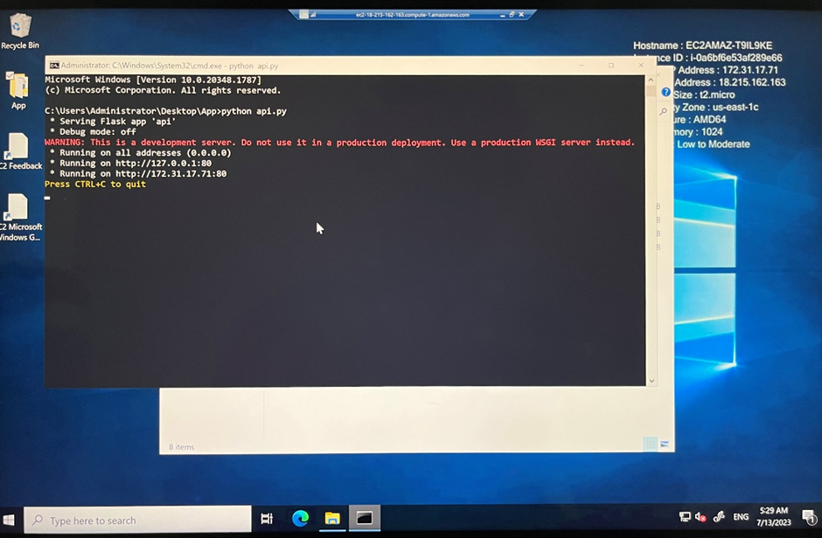
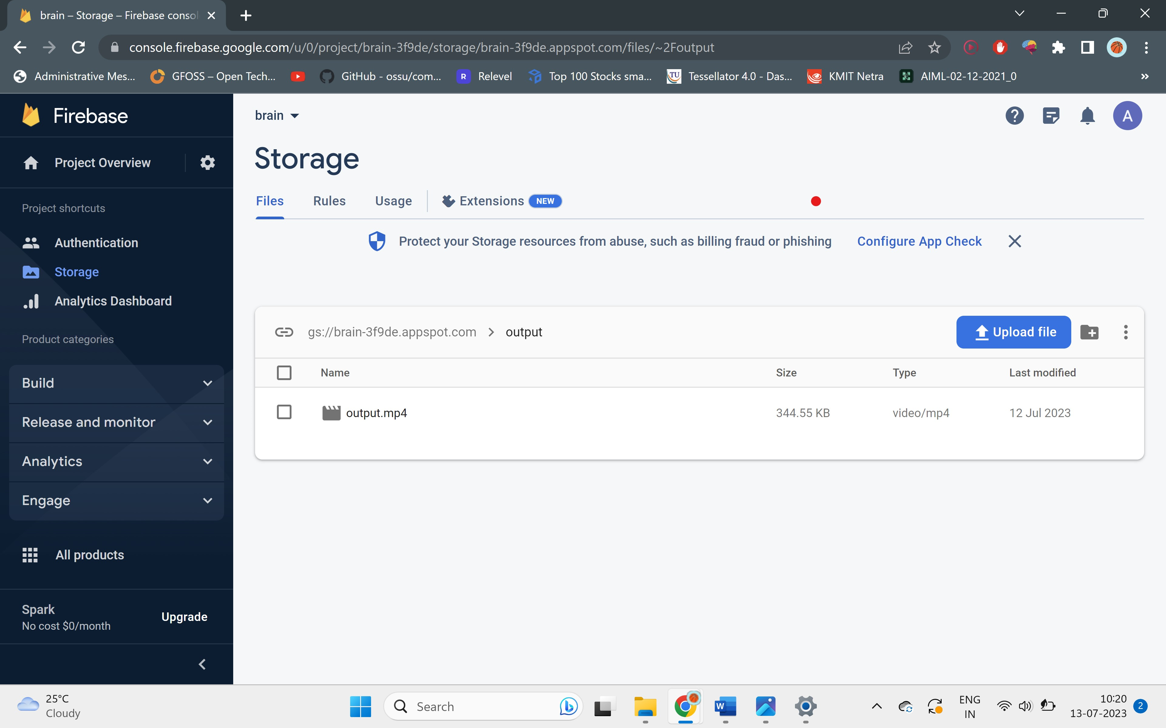
Brain Tumour Segmentation
Flutter :
Output
Flask :
AWS Instance :
FireBase Storage :

